Slide 1
Chongqing University of Technology
ATAI
Advanced Technique of Artificial Intelligence
Chongqing University of Technology
Merging Statistical Feature via Adaptive Gate for Improved Text Classification
Xianming Li,^{1†} Zongxi Li,^{2†*} Haoran Xie,³ Qing Li⁴
¹Ant Group, Shanghai, China
²Department of Computer Science, City University of Hong Kong, Hong Kong SAR
³Department of Computing and Decision Sciences, Lingnan University, Hong Kong SAR
⁴Department of Computing, The Hong Kong Polytechnic University, Hong Kong SAR
niming.lxm@antgroup.com, zongxili2-c@my.cityu.edu.hk, hrxie@ln.edu.hk, csqli@comp.polyu.edu.hk
——AAAI2021
2021.3.23 • ChongQing
Reported by Sijin Liu

Slide 2
Chongqing University of Technology
ATAI
Advanced Technique of Artificial Intelligence
Chongqing University of Technology
1.Introduction
2.Method
3.Experiments
4.Conclusion

Slide 3
Introduction
From our pilot study, we find that using statistical as an additional feature brings forth substantial improvements to various baselines.
(1) The semantic feature and statistical feature are not compatible in scale and dimension;
(2) The new information may not be necessary for all semantic features

Slide 4
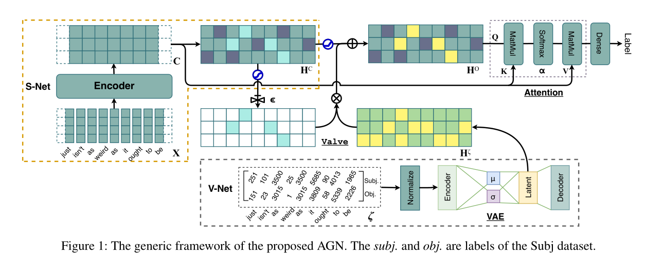
Method

Slide 5
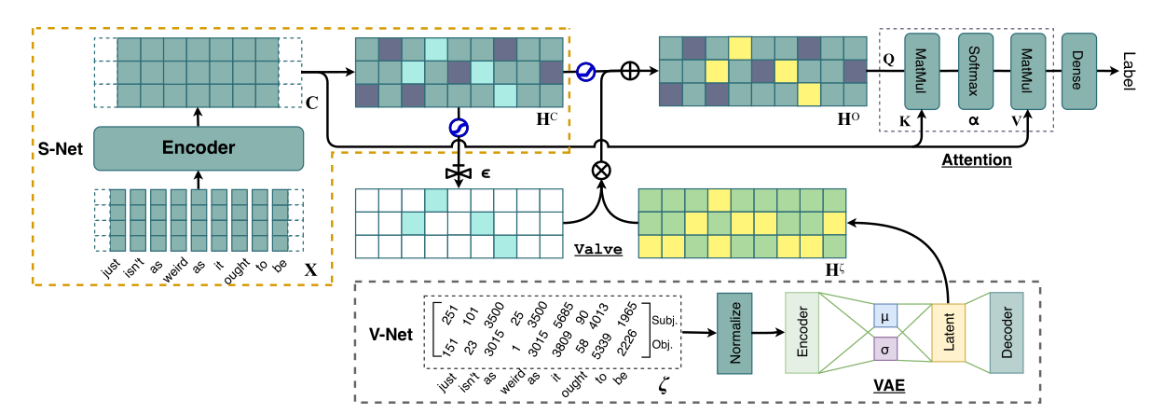
Method
Global information

Slide 6
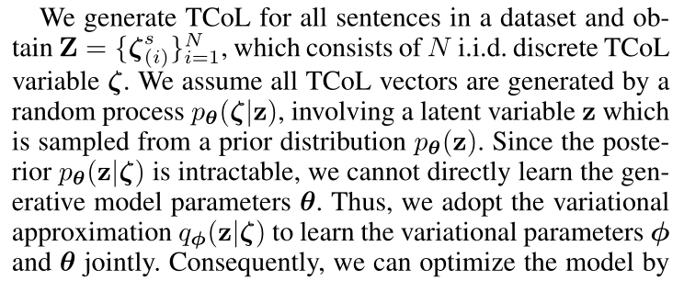
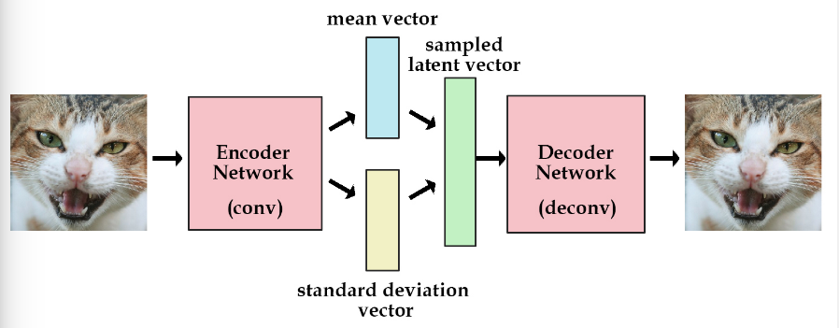
Method
V-Net: Variational Encoding Network
Notes:
我们拥有两部分输入：数据x，模型p(z, x)。
我们需要推断的是后验概率p(z | x)，但不能直接求。
构造后验概率p(z | x)的近似分布q(z; v)。
不断缩小q和p之间的距离直至收敛。
具体来说，给定一个真实样本 Xk，我们假设存在一个专属于 Xk 的分布 p(Z|Xk)（学名叫后验分布），并进一步假设这个分布是（独立的、多元的）正态分布。
这时不再是每次产生一个隐含向量，而是生成两个向量，一个表示均值，一个表示标准差，然后通过这两个统计量来合成隐含向量，这也非常简单，用一个标准正态分布先乘上标准差再加上均值就行了，这里我们默认编码之后的隐含向量是服从一个正态分布的。这个时候我们是想让均值尽可能接近0，标准差尽可能接近1。
它本质上就是在我们常规的自编码器的基础上，对 encoder 的结果（在VAE中对应着计算均值的网络）加上了“高斯噪声”，使得结果 decoder 能够对噪声有鲁棒性；而那个额外的 KL loss（目的是让均值为 0，方差为 1），事实上就是相当于对 encoder 的一个正则项，希望 encoder 出来的东西均有零均值。
那另外一个 encoder（对应着计算方差的网络）的作用呢？它是用来动态调节噪声的强度的。
为了优化KL散度，我们需要应用一个简单的参数重构技巧：不像标准自编码器那样产生实数值向量，VAE的编码器会产生两个向量:一个是均值向量，一个是标准差向量。

Slide 7
Method
Valve Component
S-Net: Semantic Representation Projection Network
the model input: $x = [x1,x2, . . . ,xm]$
Classifier

Slide 8
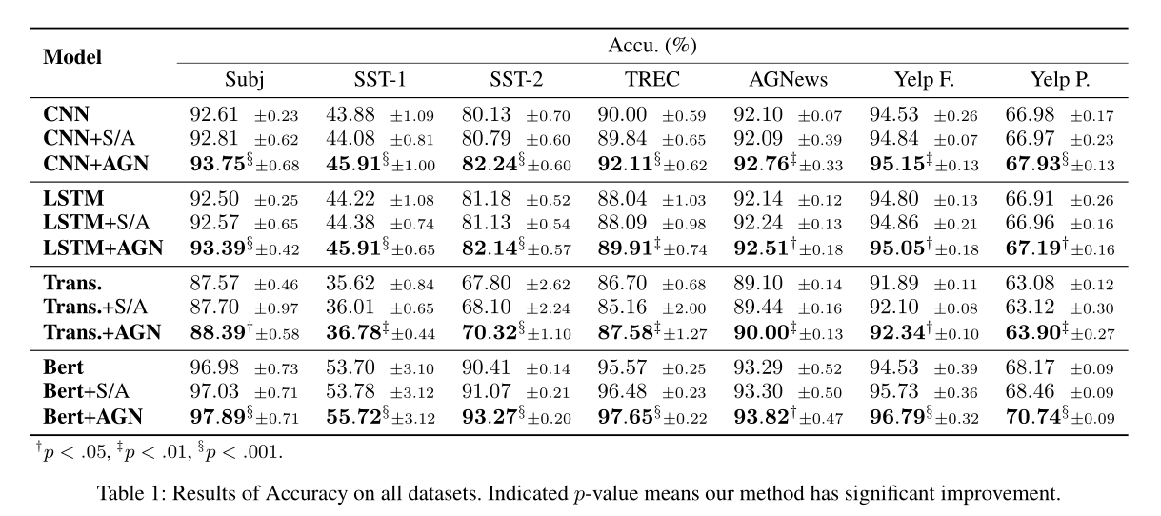
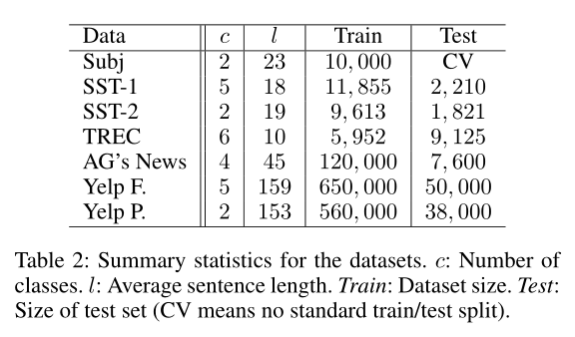
Experiments

Slide 9
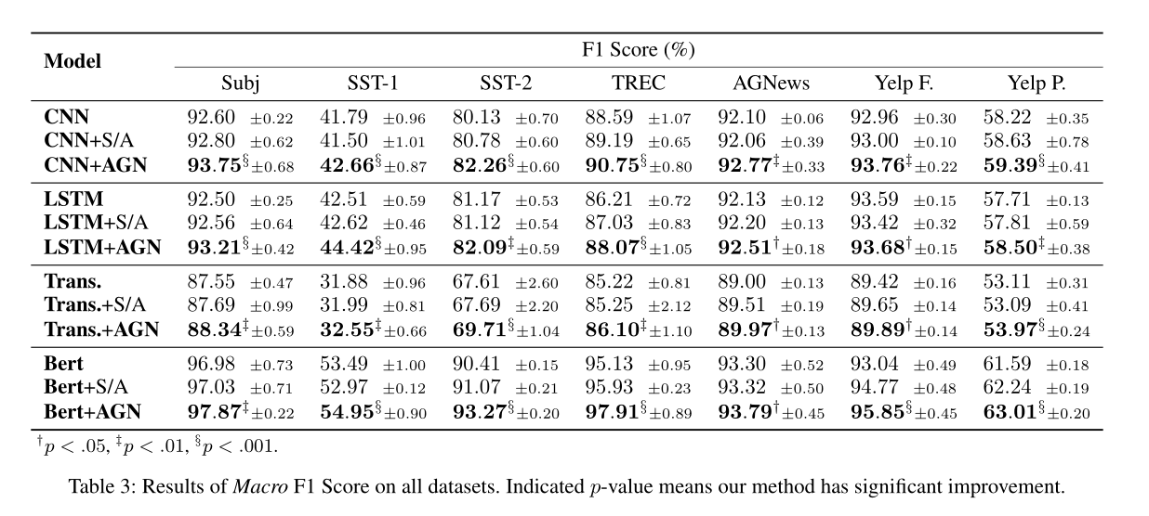
Experiments

Slide 10
Experiments

Slide 11
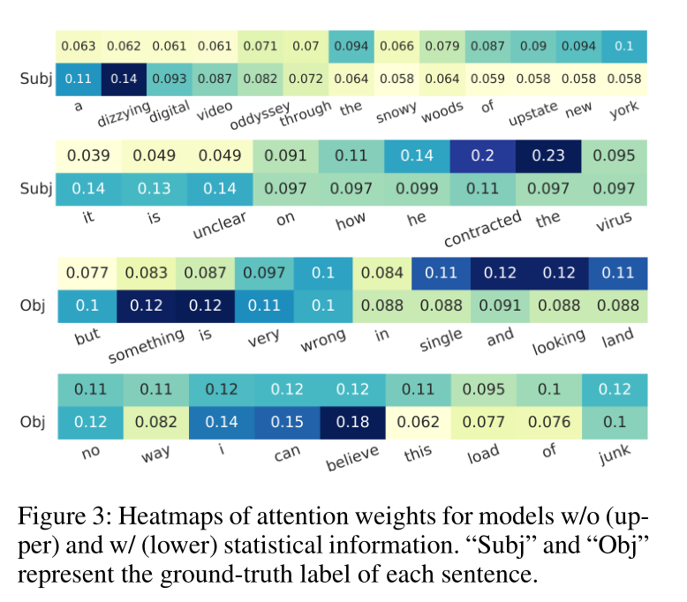
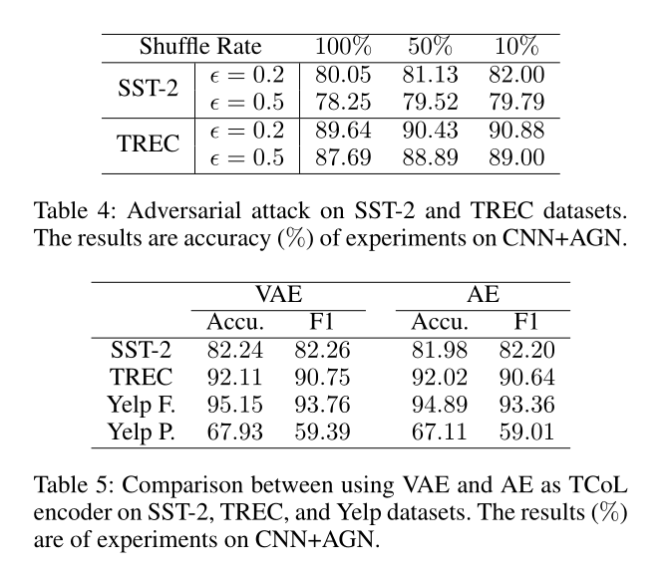
Experiments

Slide 12
Summary
In this paper, we have proposed an Adaptive Gate Network (AGN) to incorporate statistical features and conducted extensive experiments with CNN-based, RNN-based, Transformer-based, and Bert-based frameworks to demonstrate the effectiveness and robustness of our proposed AGN method. The well-designed valve mechanism enables AGN to merge necessary information while preserving essential semantic features. Given naturally biased statistical information, AGN can produce impressive improvements to baseline models. AGN has excellent flexibility in actual usage, especially when limited external information is available. For future work, we plan to apply the AGN to other tasks exploring various types of external knowledge, thereby providing a more in-depth insight into the framework design with better utilization of additional knowledge.

Slide 13
Thank you!

